Slide 1


WWW.FTIMESHARE.COM
F-TIMESHARE
Good for your choice

Slide 2

About Us
Đinh Quốc Tuấn Đạt - Team Leader
Lương Ngọc Phương Duy
Nguyễn Thị Ngọc Hân
Ngô Phạm Thảo Vy
Nguyễn Đức Quý

Slide 3
Problems
Of people who want to rent a real-estate for their vacation
Of people who have free real-estate
Manage booking
Difficult to manage
Personal information security
Hard to find customer
Safety in payment phase
Risk of being guile

Slide 4
F-Timeshare is the solution!
Designed to revolutionize the way customers experience timeshare, the FTimeshare system offers seamless integration of technology and convenience, optimizes the booking experience, and manages the timeshare process:
- Effortless Booking & Scheduling
-Transparent Financial Management
-Personalized Owner Experience

Slide 5
Benefits
F-Timeshare
Customer
Timeshare owner
Clear in payment
Easy at finding customer
Easy at finding and booking timeshare service
Timeshare financial management
Booking management
Manage Timeshare products
User information security
Protect user right with F-Timeshare staff

Slide 6




ROLES OF PROJECT
Admin
Staff
Customer

Slide 7
Use case - Customer
Manage Revenue
Search Timeshare
Feedback, Report
Customer
Manage Booking
Create timeshare
Manage Timeshare products

Slide 8
Use case - Staff
Edit news
Search Timeshare
Accpet/Reject booking request
Staff
Create News
Manage timeshare's status
View customer payment's bill

Slide 9
Use case - Admin
View Total Revenue
Search Timeshare
Block Account User
Admin
Manage Staff List
View User List
Manage Report

Slide 10
Application Design

Slide 11
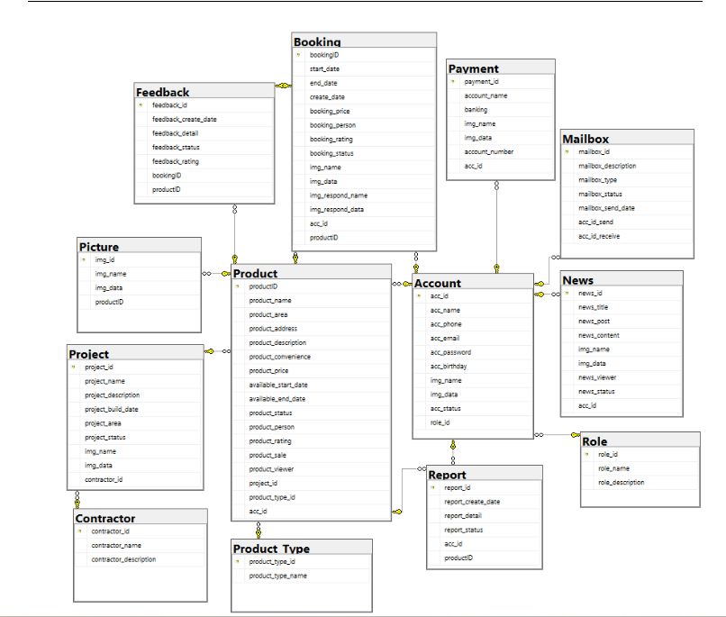
Database schema

Slide 12
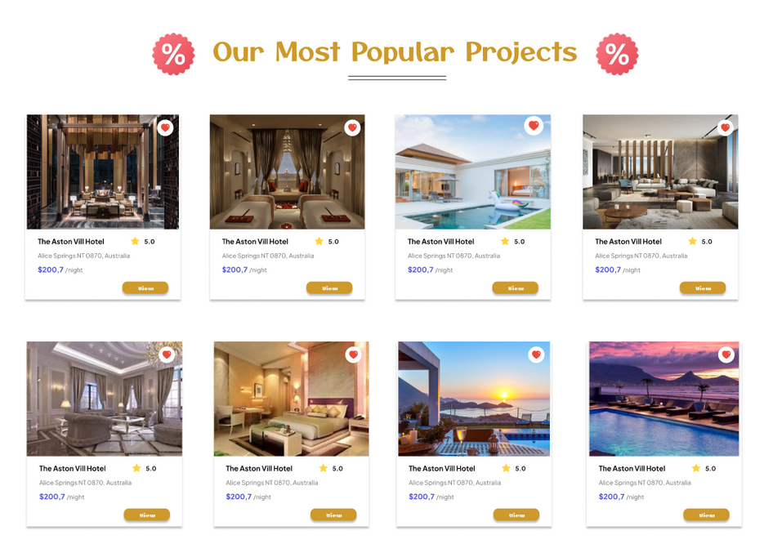
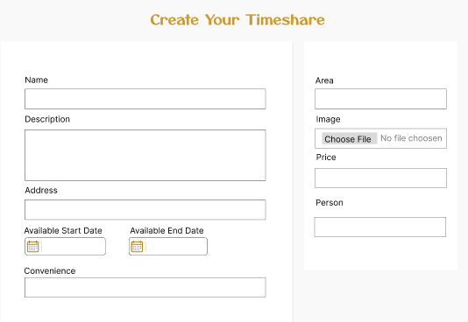
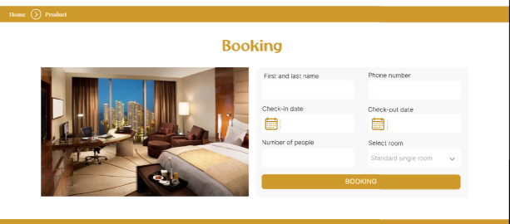
F-Timeshare
View Timeshare
UI Design
Create Timeshare
Booking

Slide 13




Technology
Springboot framework
Spring Security and JWT Authentication
Reactjs

Slide 14

F-Timeshare
Demo

